Slide 1

MACHINE LEARNING

Slide 2
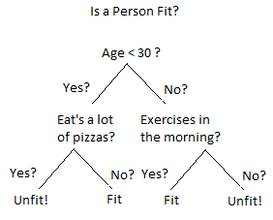
DECISION TREE
A decision tree is a supervised Machine learning algorithm
It is used for both classification and regression problems.
It is mostly used for classification tasks.
The goal is to build a model to predict the value of the target label by using simple decision rules inferred from data.

Slide 3
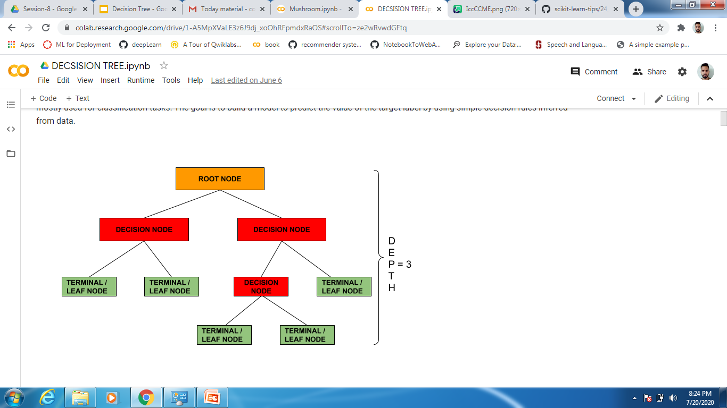
UNDERSTANDING THE BASIC TERMINOLOGIES OF DECISION TREE
A root node is the one where population data is present before any split.

Slide 4
UNDERSTANDING THE BASIC TERMINOLOGIES OF DECISION TREE
When a sub-node get divided further into sub nodes it is known as decision node.

Slide 5
UNDERSTANDING THE BASIC TERMINOLOGIES OF DECISION TREE
A node which does not get divided further into sub nodes is known as leaf/terminal node

Slide 6
UNDERSTANDING THE BASIC TERMINOLOGIES OF DECISION TREE
Depth is the longest path from root node to the leaf node.

Slide 7
UNDERSTANDING THE BASIC TERMINOLOGIES OF DECISION TREE
Splitting -
Process of dividing a node further into sub nodes.

Slide 8
UNDERSTANDING THE BASIC TERMINOLOGIES OF DECISION TREE
Pruning-
It is opposite of splitting. When a tree is fully grown we remove the sub nodes

Slide 9
DECIDING THE BEST SPLIT
A decision tree uses multiple algorithms to decide to split a node into different sub nodes.
The sub nodes should be more homogenous than previous node. As we go on splitting the homogeneity increases.
A decision tree split the nodes on all the available variables and selects the one which results in more homogenous nodes.
Marks in 12th | Entrance marks | Admitted

Slide 10
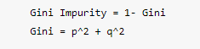
GINI
The goal of any learning algorithm in decision tree is to find the best split.
Gini impurity measures the disorder of the set of elements.

Slide 11
How to decide on which variable to split first ?
FEATURES
ATTEND TUITION
CO-CURRICULAR ACTIVITIES
Total Students | 20
Pass | 12
Fail | 8
P (pass) = 12/20
P (fail) = 8/20

Slide 12
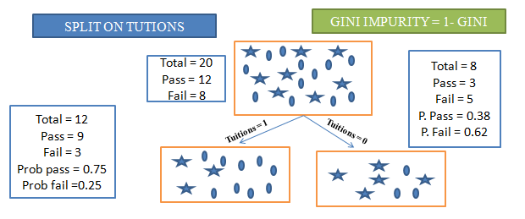
We will calculate the gini impurity for both the split and select the one with less impurity.
SPLIT ON TUTION
At root node p = 12/20 which equals 0.6
and q = 8/20 which equals 0.4
Gini at the root node = p^2 + q^2 = 0.6^2 + 0.4^2
Impurity = 1 - Gini
Impurity = 1 - 0.52 = 0.48
So at the root node we have impurity = 0.48.
Star represents fail and circle represents pass

Slide 13
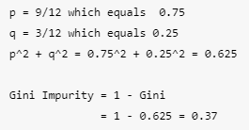
After the split we have 12 values in left node and 8 values in right node
SPLIT ON TUTION
For the left sub node
Star represents fail and circle represents pass

Slide 14
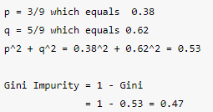
After the split we have 12 values in left node and 8 values in right node
SPLIT ON TUTION
For the right sub node
Star represents fail and circle represents pass

Slide 15
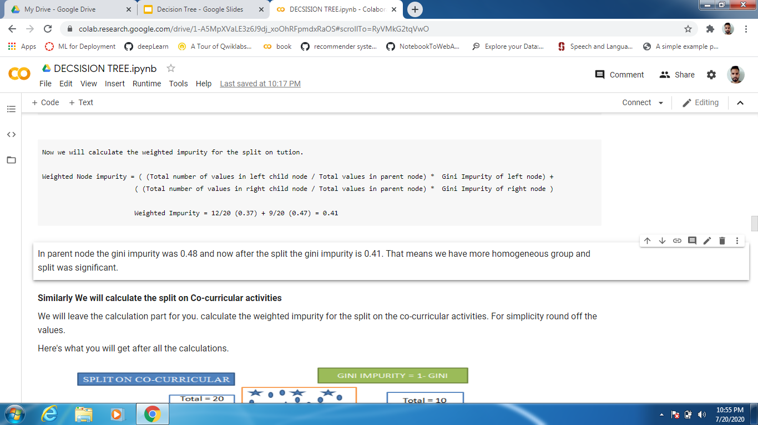

Slide 16
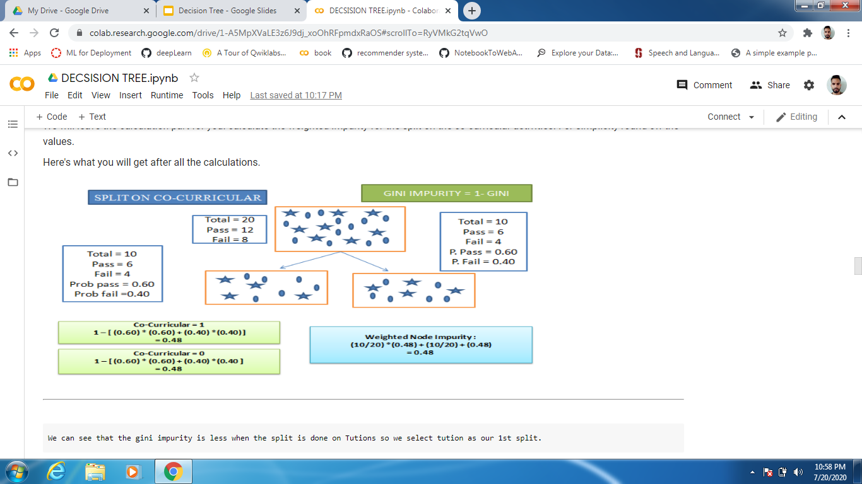
SPLIT ON CO-CURRICULAR

Slide 17
COMPARE AND SELECT THE SPLIT WITH LESS IMPURITY
GINI IMPURITY IN PARENT NODE | 0.48
GINI IMPURITY FOR SPLIT ON TUTION | 0.41
GINI IMPURITY FOR SPLIT ON CO-CURRICULAR | 0.48

Slide 18
ADVANTAGES OF DECISION TREE
Decision trees are simple to interpret and visualize.
Requires less effort for data preparation compared to other algorithms.
Useful in data exploration. Decision trees are one of the fastest ways to identify the most significant variables.
A decision tree can handle both categorical and numerical variables.
A decision tree can handle missing values.

Slide 19
DISADVANTAGES OF DECISION TREE
Decision trees are very prone to overfitting.
A small change in data can cause a large change in the structure of the decision tree.
Decision trees are relatively expensive as complexity and time taken is more.

